Slide 2

$κ$-Curves: Interpolation at Local Maximum Curvature
Zhipei Yan¹, Stephen Schiller², Gregg Wilensky³, Nathan Carr², Scott Schaefer¹
¹Texas A&M University, ²Adobe Research, ³Adobe
Notes:
Nothing

Slide 3
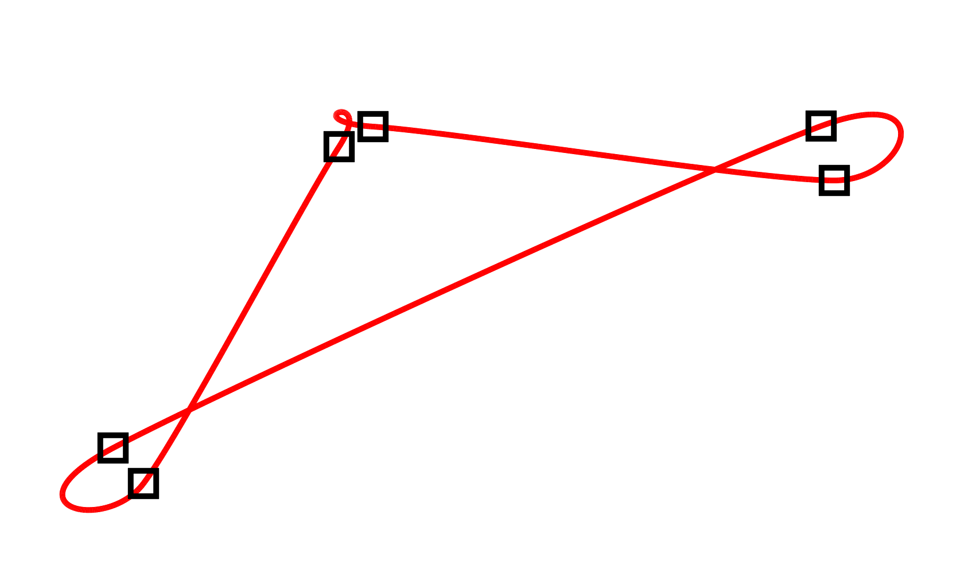
Problems with Interpolation
Catmull-Rom Spline
Notes:
Try to provide tool. Rare people use , shape problems….
Curvature geometric feature.

Slide 4
“… human visual system is sensitive to minima and maxima of curvature …”
“… all curvature extrema should coincide with the given control points …”
[Levien 2009]

Slide 5
Desired Properties
Interpolate all control points
Max curvatures (salient points) only occur at control points
---- No cusps except at control points
Curvature continuous

Slide 6
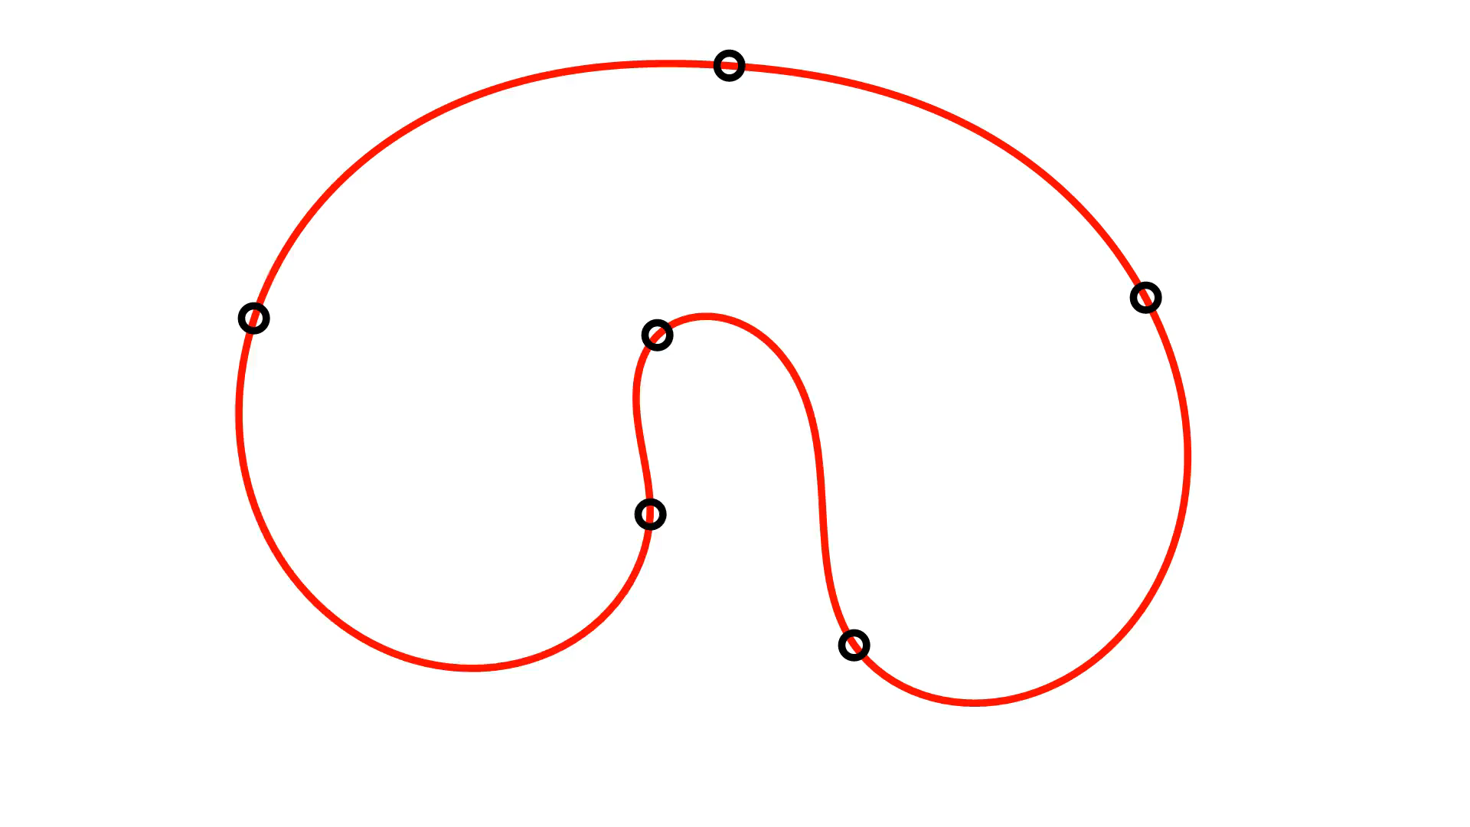
Clothoid
Linear curvature
Not continuous with
motion of control points
Notes:
Pics texts.

Slide 7
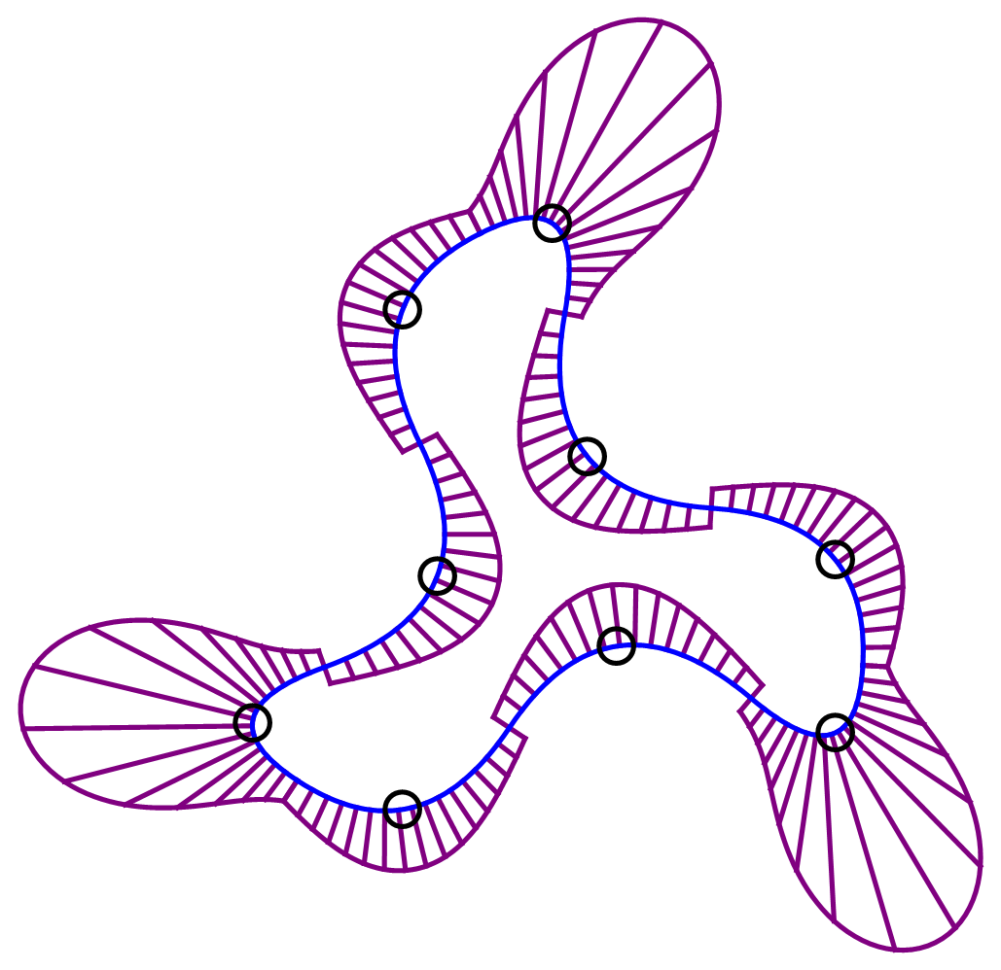
Quadratic spline

Slide 8
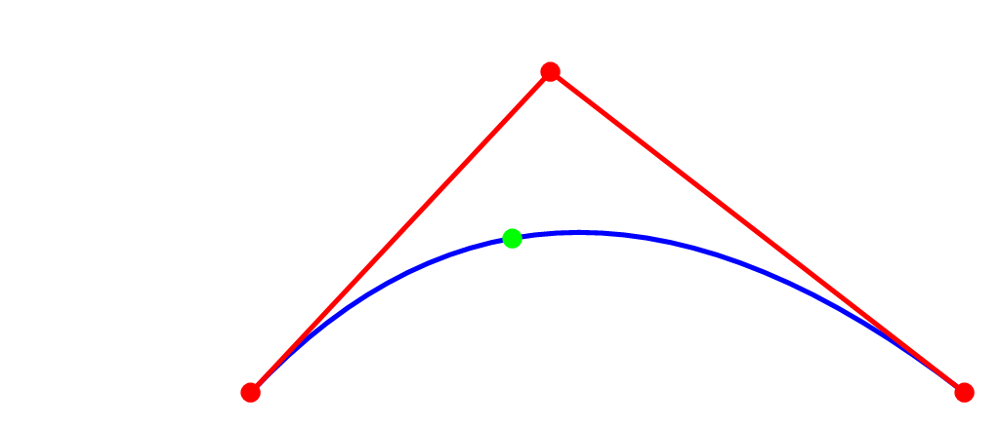
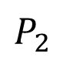
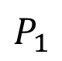
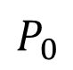
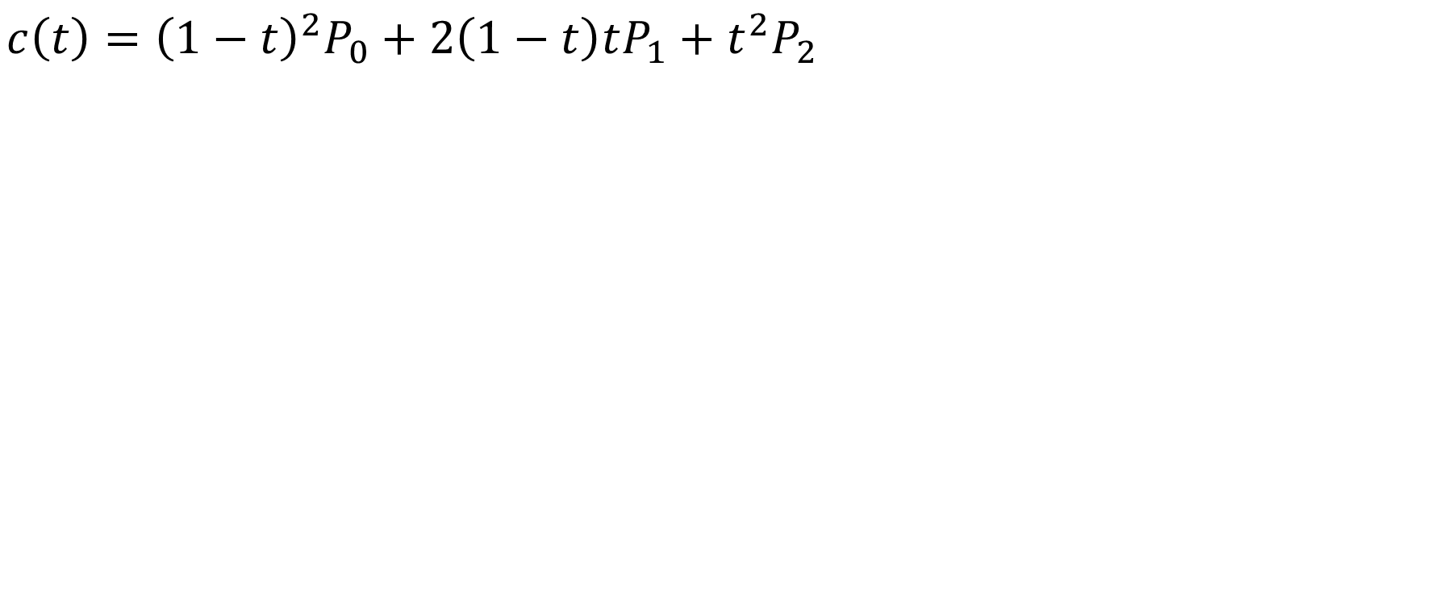
Quadratic Bezier Curve
$$c\left(t\right)={\left(1−t\right)}^{2}P_{0}+2\left(1−t\right)tP_{1}+t^{2}P_{2}$$
$$P_{1}$$
$$P_{2}$$
$$P_{0}$$
Notes:
location

Slide 9
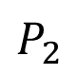
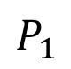
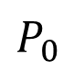
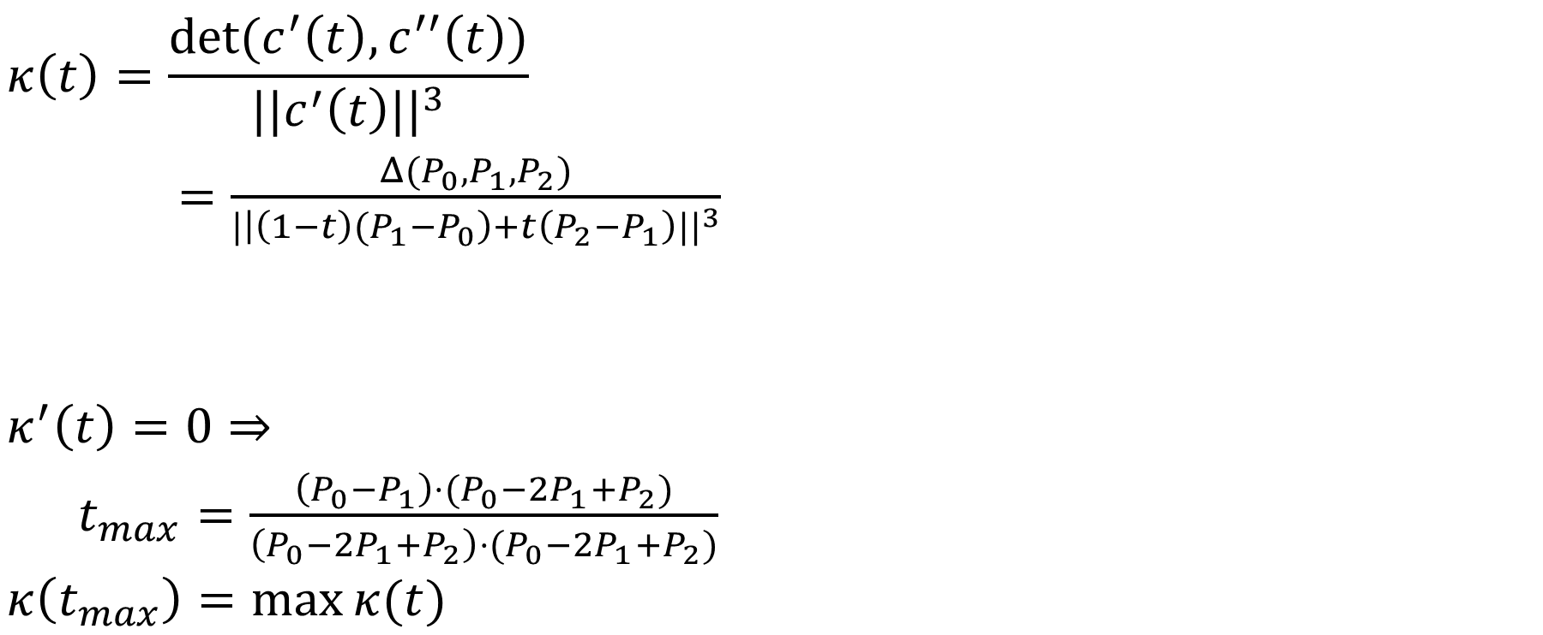
Quadratic Bezier Curvature
$$κ\left(t\right)=\frac{det⁡(c^{′}\left(t\right),c^{′′}\left(t\right))}{{||c^{′}\left(t\right)||}^{3}}$$
$=\frac{Δ(P_{0},P_{1},P_{2})}{{|\left|\left(1−t\right){(P}_{1}−P_{0}\right)+t\left(P_{2}−P_{1}\right)||}^{3}}$
$$κ^{′}\left(t\right)=0⇒$$
$t_{max}=\frac{\left(P_{0}−P_{1}\right)⋅(P_{0}−{2P}_{1}+P_{2})}{\left(P_{0}−{2P}_{1}+P_{2}\right)⋅(P_{0}−{2P}_{1}+P_{2})}$
$$κ\left(t_{max}\right)=\max{κ(t)}$$
$$P_{1}$$
$$P_{2}$$
$$P_{0}$$
Notes:
spacing

Slide 10
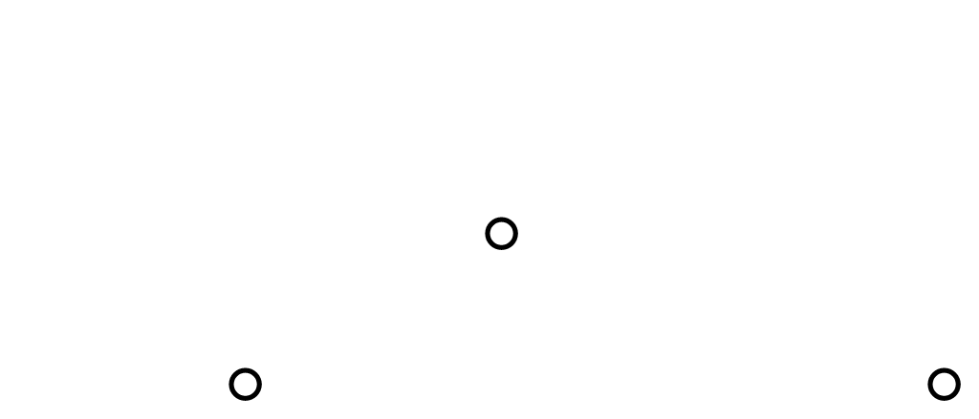
Interpolation at Max Curvature

Slide 11
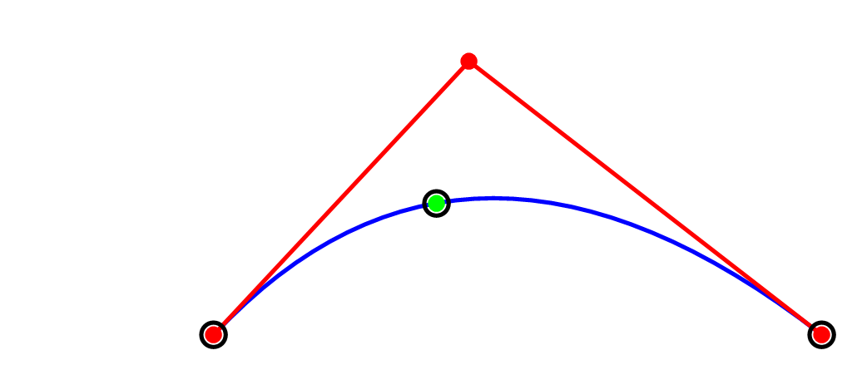
Interpolation at Max Curvature

Slide 12
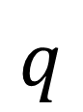
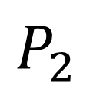
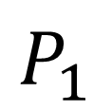
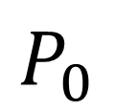
Quadratic Time Parameter
$$P_{1}$$
$$q$$
$$P_{0}$$
$$P_{2}$$
$$q={\left(1−t\right)}^{2}P_{0}+2\left(1−t\right)tP_{1}+t^{2}P_{2}$$

Slide 13
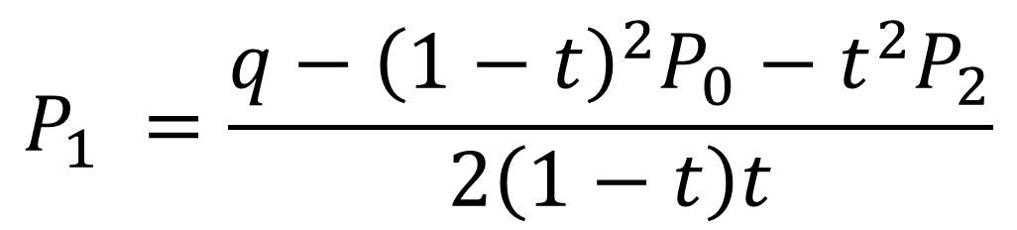
Quadratic Time Parameter
$$P_{1}$$
$$q$$
$$P_{0}$$
$$P_{2}$$
$$P_{1} =\frac{q−{\left(1−t\right)}^{2}P_{0}−t^{2}P_{2}}{2\left(1−t\right)t}$$
Notes:
Know p0, q, p2. Want to compute p1

Slide 14
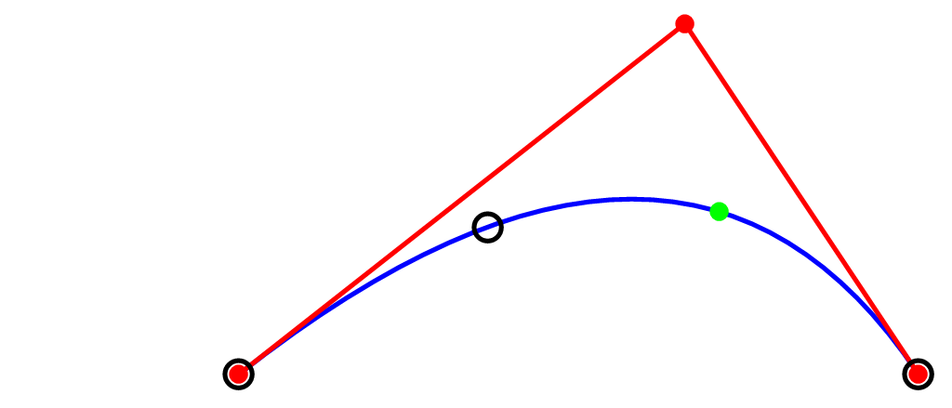
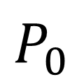
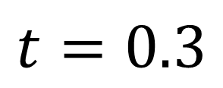
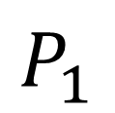
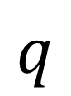
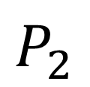
Quadratic Time Parameter
$$P_{1}$$
$$t=0.3$$
$$q$$
$$P_{0}$$
$$P_{2}$$

Slide 15

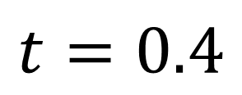
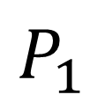
Quadratic Time Parameter
$$P_{1}$$
$$t=0.4$$
$$q$$
$$P_{0}$$
$$P_{2}$$

Slide 16
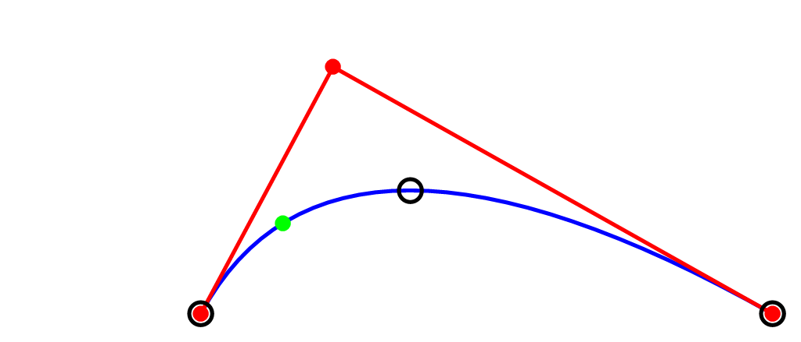
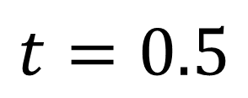
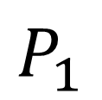
Quadratic Time Parameter
$$P_{1}$$
$$t=0.5$$
$$q$$
$$P_{0}$$
$$P_{2}$$

Slide 17
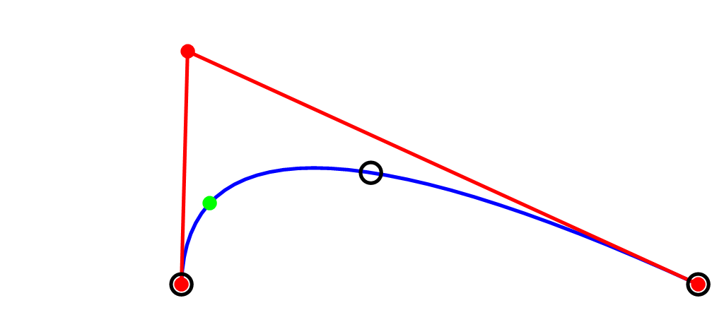
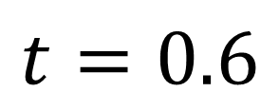
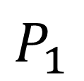
Quadratic Time Parameter
$$P_{1}$$
$$t=0.6$$
$$q$$
$$P_{0}$$
$$P_{2}$$

Slide 18
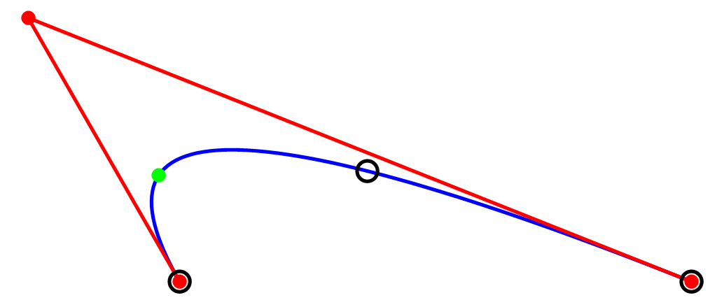
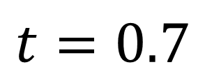
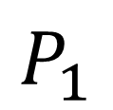
Quadratic Time Parameter
$$P_{1}$$
$$t=0.7$$
$$q$$
$$P_{0}$$
$$P_{2}$$

Slide 19
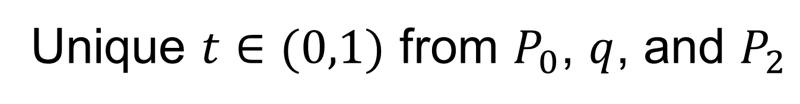
Quadratic Time Parameter
$$P_{1}$$
$$q$$
$$P_{0}$$
$$P_{2}$$
Unique $t∈(0,1)$ from $P_{0}$, $q$, and $P_{2}$

Slide 20
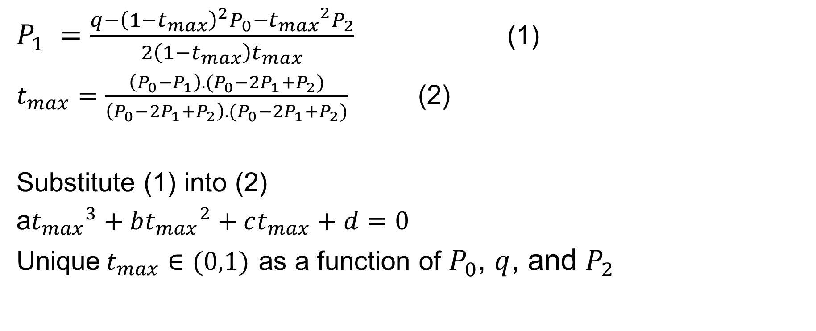
Computation of Max Curvature Time
$P_{1} =\frac{q−{\left(1−t_{max}\right)}^{2}P_{0}−{t_{max}}^{2}P_{2}}{2\left(1−t_{max}\right)t_{max}}$ (1)
$t_{max}=\frac{\left(P_{0}−P_{1}\right).(P_{0}−{2P}_{1}+P_{2})}{\left(P_{0}−{2P}_{1}+P_{2}\right).(P_{0}−{2P}_{1}+P_{2})}$ (2)
Substitute (1) into (2)
a${t_{max}}^{3}+b{t_{max}}^{2}+ct_{max}+d=0$
Unique$t_{max}∈(0,1)$ as a function of $P_{0}$, $q$, and $P_{2}$

Slide 21
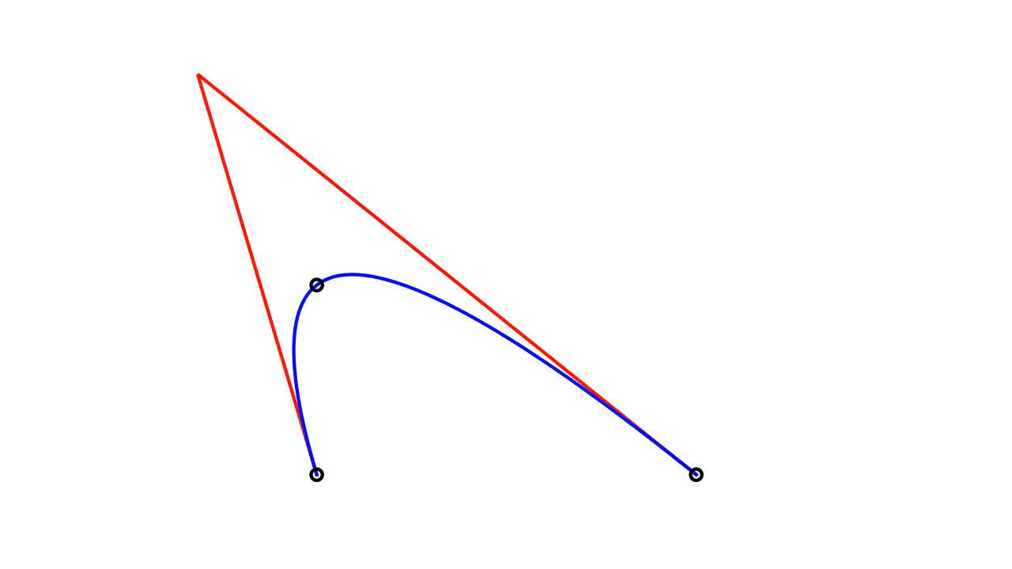

Slide 22
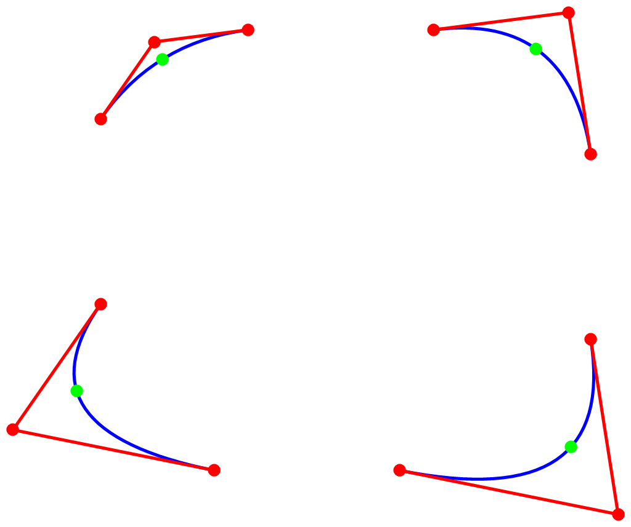
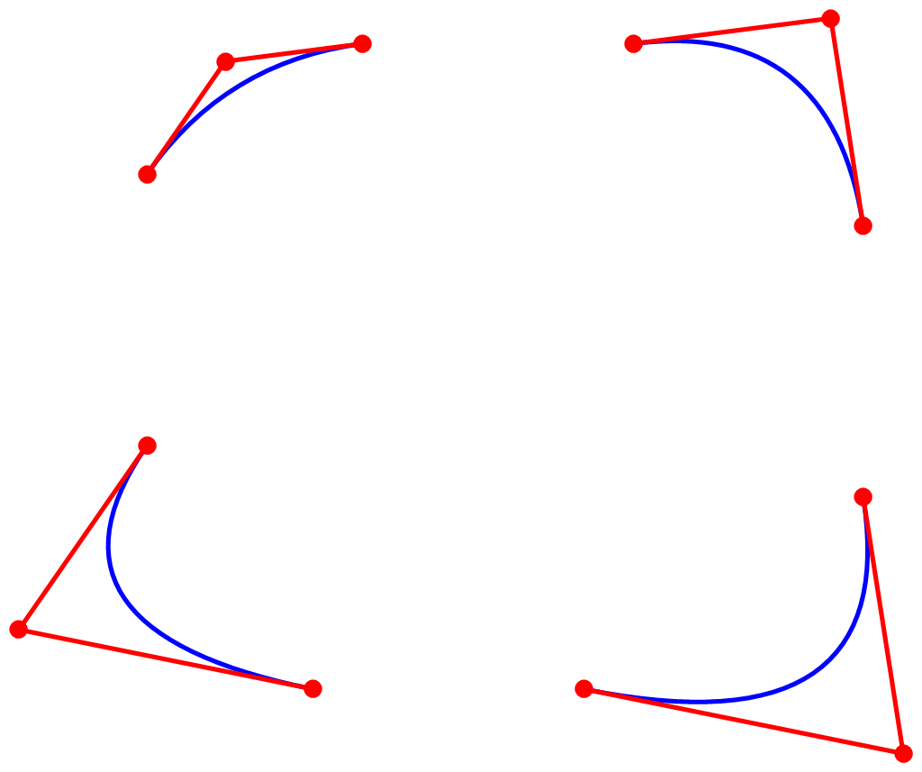
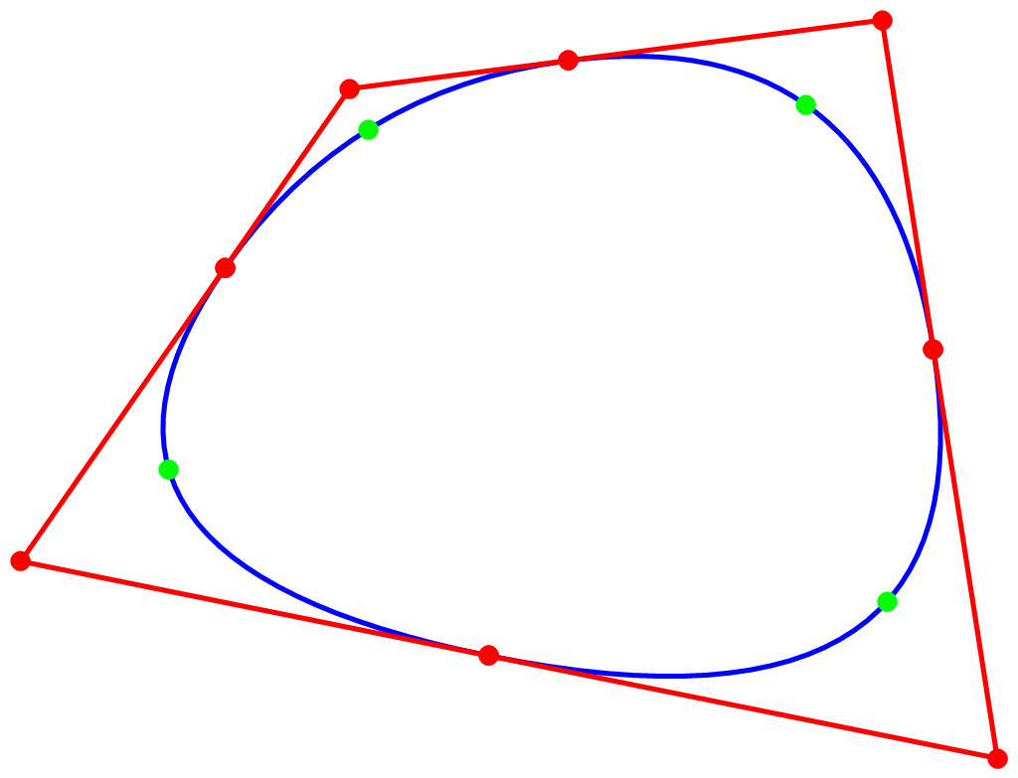
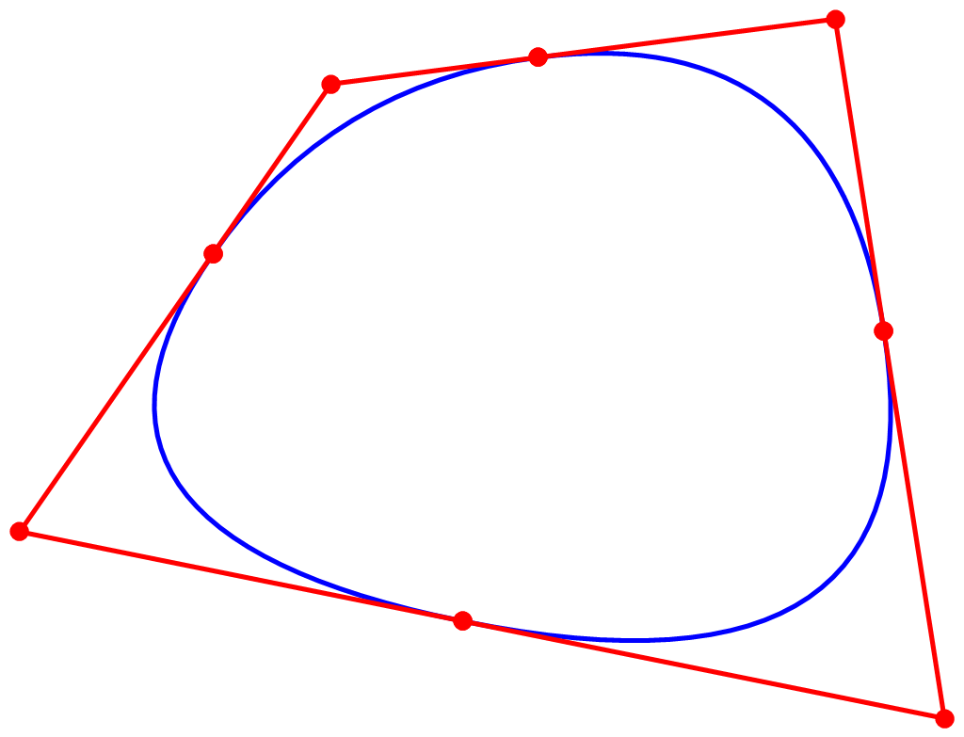

Slide 23
Related works
[Schaback 1989]

Slide 24
Related works
[Schaback 1989]
Use input points as
splliting points

Slide 25
Related works
[Feng et al. 1995]
Interpolate tangent
vectors at control points
No curvature control.
Notes:
Interpolation scheme. Properties. No curvature control.

Slide 26
G² Condition

Slide 27
G² Condition

Slide 28
G² Condition

Slide 29
G² Condition
D
C
B
A
C=(1-λ)B+λD
E

Slide 30
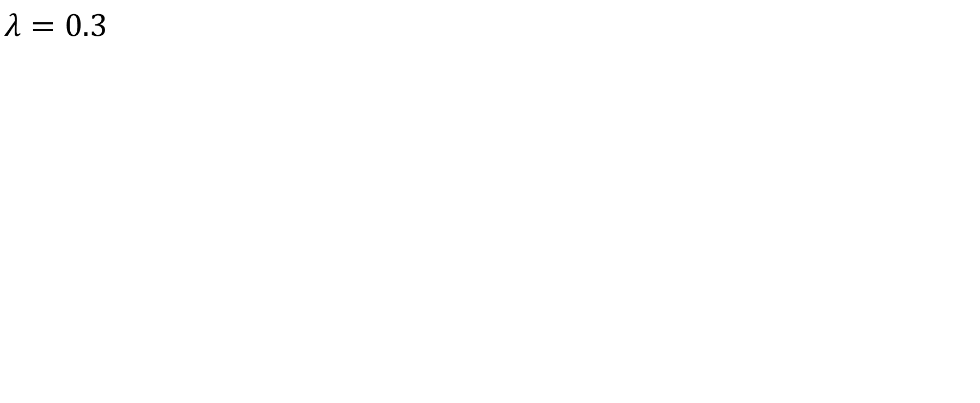
G² Condition
$$λ=0.3$$

Slide 31
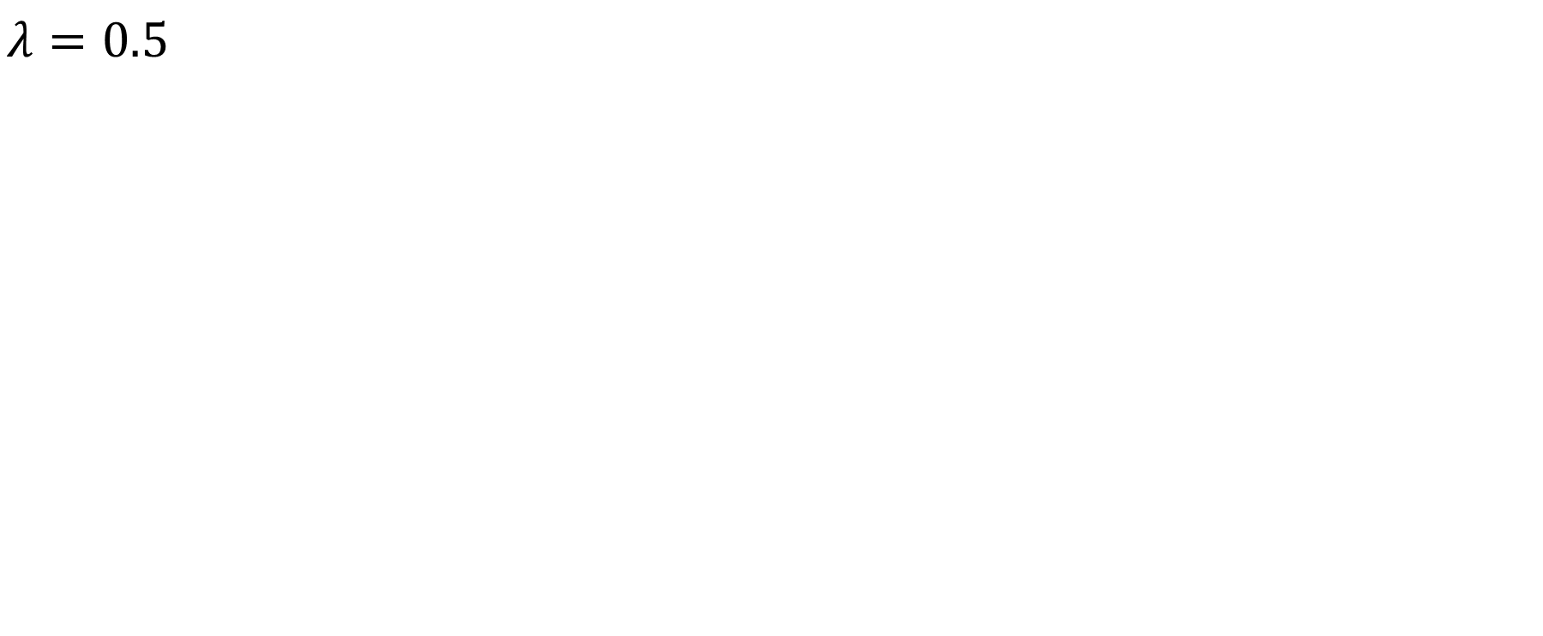
G² Condition
$$λ=0.5$$

Slide 32
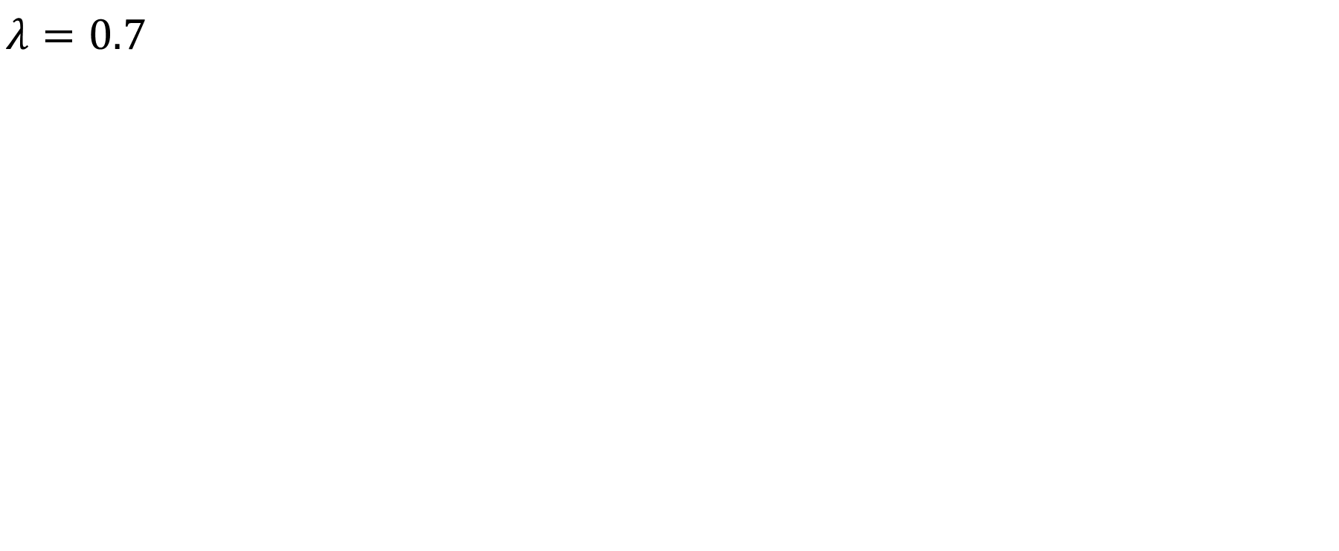
G² Condition
$$λ=0.7$$

Slide 33
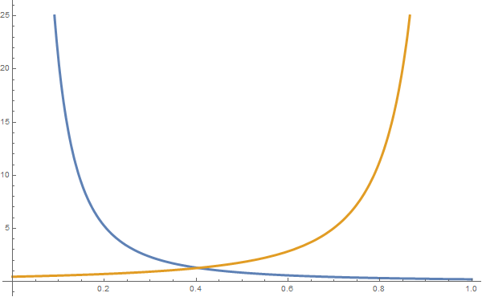
Curvature

Slide 34
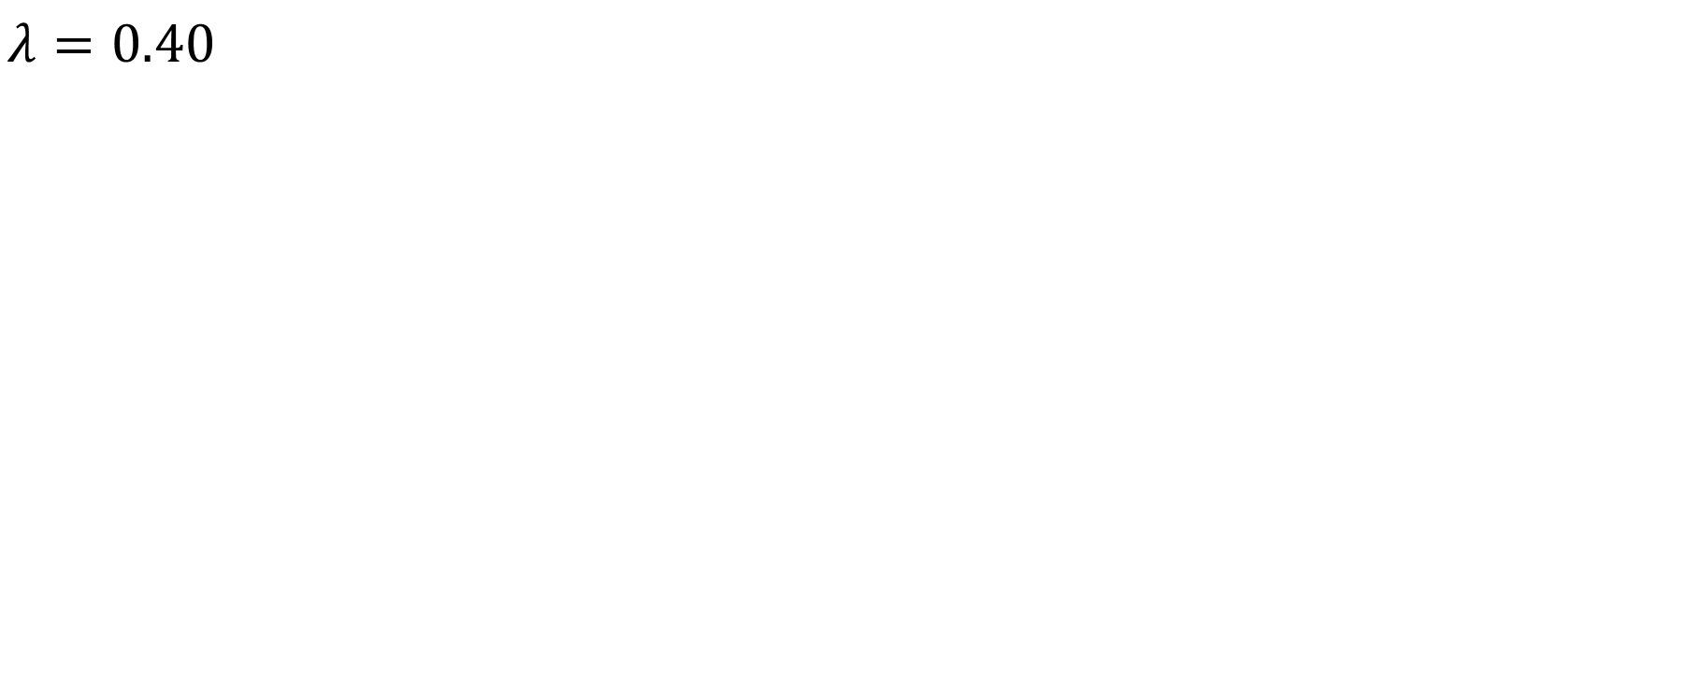
G² Condition
$$λ=0.40$$

Slide 35
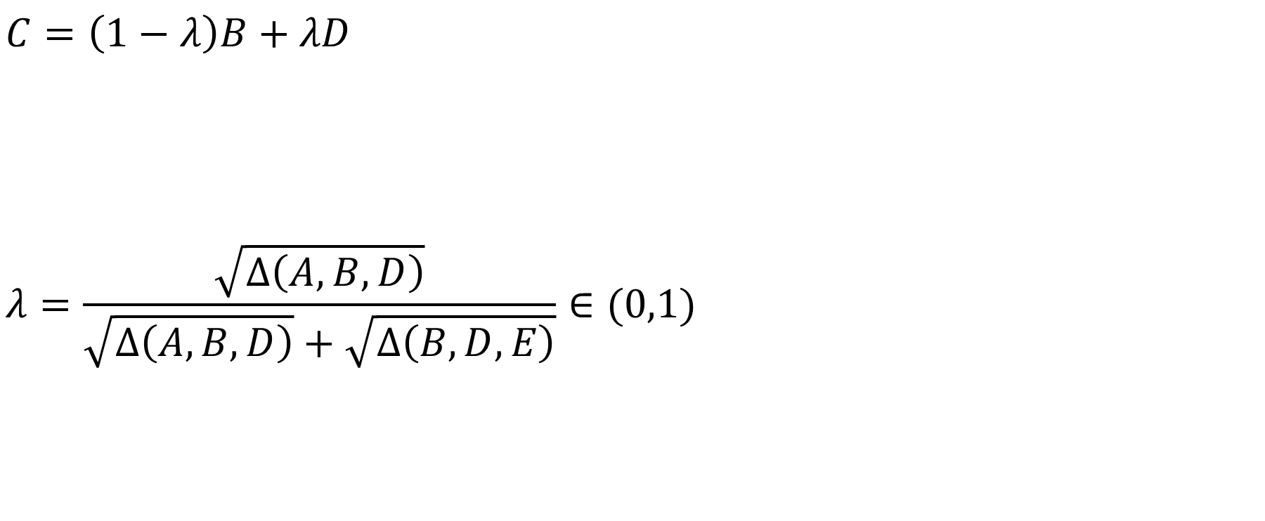
G² Joint
C
$$C=\left(1−λ\right)B+λD$$
$$λ=\frac{\sqrt{Δ\left(A,B,D\right)}}{\sqrt{Δ\left(A,B,D\right)}+\sqrt{Δ\left(B,D,E\right)}}∈(0,1)$$
B
D
A
E

Slide 36
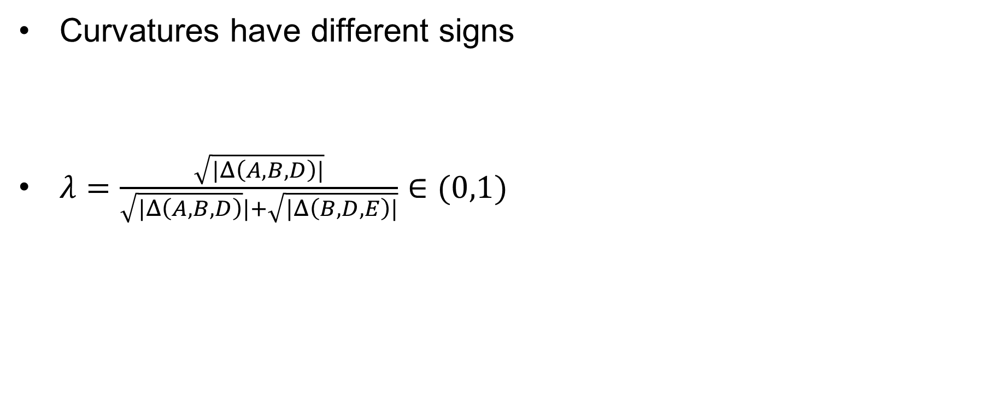
Inflection Point
E
Curvatures have different signs
$λ=\frac{\sqrt{|Δ\left(A,B,D\right)|}}{\sqrt{|Δ\left(A,B,D\right)}|+\sqrt{|Δ\left(B,D,E\right)|}}∈(0,1)$
C
D
B
A
Notes:
normals

Slide 37



Inflection Point
Notes:
No matter how many segments

Slide 38
Optimization

Slide 39
Optimization
Input

Slide 40
Optimization
Initialization

Slide 41
Optimization

Slide 42
Optimization
Iteration 0
p_{i}
c_{i,2}
c_{i,0}
t_{i}

Slide 43
Optimization
Iteration 0
c_{i,1}
λ_{i}
c_{i+1,1}
c_{i,0}
c_{i+1,2}

Slide 44

Optimization
Iteration 0
c_{i,1}
c_{i,2}
$${\left(1−t_{i}\right)}^{2}c_{i,0}+2\left(1−t_{i}\right)c_{i,1}+t^{2}c_{i,2}=p_{i}$$
c_{i,0}
t_{i}
$$c_{i,2}=\left(1−λ_{i}\right)c_{i,1}+λ_{i}c_{i+1,1}$$
Only $c_{i,1}$ is variable.

Slide 45



Step 2
$$\left[\begin{matrix}a11 & a12 & & & & a1n \\ a21 & a22 & a23 & & & \\ & a32 & ⋱ & ⋱ & & \\ & & ⋱ & ⋱ & ⋱ & \\ & & & ⋱ & ⋱ & an−1,n \\ an1 & & & & an,n−1 & ann\end{matrix}\right]$$
$$\left[\begin{matrix}c1,1 \\ c2,1 \\ c3,1 \\ ⋮ \\ ⋮ \\ cn,1\end{matrix}\right]$$
$$\left[\begin{matrix}p1 \\ p2 \\ p3 \\ ⋮ \\ ⋮ \\ pn\end{matrix}\right]$$
=

Slide 46
Optimization
Iteration 1

Slide 47
Optimization
Iteration 2

Slide 48
Optimization
Iteration 3

Slide 49
Optimization
Iteration 4

Slide 50
Optimization
Iteration 5

Slide 51
Optimization
Iteration 10

Slide 52


Slide 53

Curves with Boundaries

Slide 54


Local support in practice
Notes:
Explain. Loop.

Slide 55

Results and Examples

Slide 56


Adobe Illustrator

Slide 57

Adobe Illustrator

Slide 58

Adobe Illustrator

Slide 59

Conclusions
Quadratic spline
G² continuous (G¹ at inflection points)
Max curvatures only appear at control points
Cusps only appear at control points
Local support in practice

Slide 60
Future work
Kappa curve can suit any curve primitives which have unique max curvature point
High degree like cubic curve
Rational curves
Integral curves
Curves in 3D

